Slide 1
Requirements Engineering – Part 1
Dr Simon Lock

Slide 2
Some Definitions
Requirements Engineering: process of establishing the features that client requires from a system and…
constraints under which such features must operate
The Requirements: the descriptions of the system services and constraints that are generated during the requirements engineering process

Slide 3
Why do Requirements Engineering
We need to know what to build before we can build it !
A common trap is to think we know what client wants
And blaze ahead with coding before we are really sure
But then realise later on that that we were wrong !
Having wasted lots of time, effort, money (and grades)
Better make sure everyone has a clear understanding
And only then proceed to design and implementation
True also for agile: even if it is a “bit-by-bit” approach

Slide 4
System Stakeholders
Before we begin, we must think about system context
What people or organisations are effected by system ?
They have a legitimate vested interest in the system
So we must consider their needs and opinions
Such stakeholders might include:
End users
System managers
System owners
General public
Legislators
Etc. etc.

Slide 5
Stakeholder Brainstorm
Imagine a system for use in a urban park setting
Can we identify all of the stakeholders ?
Recreational users
Dog walkers
Neighbours (non-users)
City Council
Park wardens
Homeless people
Property developers

Slide 6
Two main types of requirement
Functional requirements
Statements of services the system should provide
How the system should react to particular inputs
How the system should behave in particular situations
May also state what the system should NOT do
Non-functional requirements
Constraints ON the services or functions offered by system
Often apply to whole system, not just individual features
SPE groups typically can’t identify these very well !
Because they are much more subtle "quality" attributes…

Slide 7
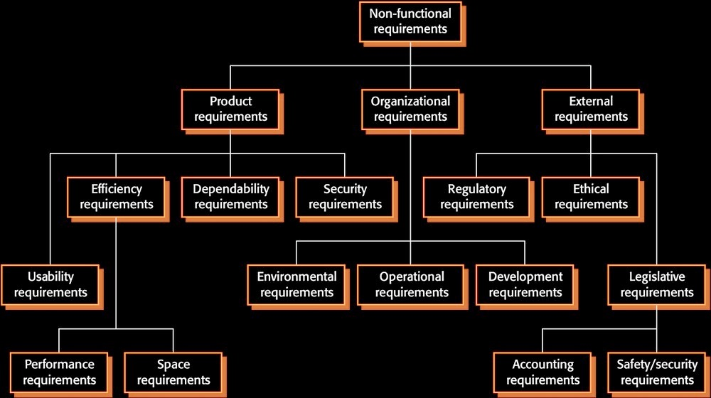
Types of Non-functional Requirement

Slide 8
Verifiability of Requirements
We should try to ensure that requirements are verifiable
No point specifying something that can't be "ticked off"
For example, the following is an unverifiable "objective":
The system should be easy to use by medical staff and should be organized so that user errors are minimised.
In comparison, the following is a testable requirement:
Medical staff shall be able to use all system functions after four hours of training. After this training, the average number of errors made by experienced users shall not exceed two per hour of system use.

Slide 9
Completeness and Consistency
In principle, requirements docs should be both:
Complete – Include descriptions of all facilities required
Consistent – Not include any conflicts or contradictions
In practice (because of real-world complexity) it is impossible to produce a totally complete and consistent requirements document.
All we can do is our best !
And acknowledge req. docs are never perfect

Slide 10
Eliciting Requirements
How do we actually go about "digging up" reqs ?
We can't just "know" them, we have to "discover" them
They can be elicited using a variety of techniques:
Reading organisational documentation
Interviewing various stakeholders
Observation of "lived" work practices
Analysis of existing systems
Evaluative approaches (simulations and exercises)
Often we will get requirements from all of these sources
You may find some/all of them useful in your projects !

Slide 11
Documentation
Organisations often have much documentation…
Process descriptions, Regulations, Manuals etc.
If we can get hold of these and pick them apart…
We can understand how organisation operates
And then specify reqs to support that operation
Be aware - people don't always follow official regs
Identifying work-arounds in use is essential !

Slide 12
Documentation Example
Let’s suppose that we were implementing an automated control system for driverless trains
Clearly we should understand lots about domain !
The Driver Manual issued by the Rail Safety and Standards Board would be essential reading
(see media folder)
At nearly 1000 pages, plenty of info in there !

Slide 13
Interview
An obvious way to find out about organisation is to talk to stakeholders (workers, manager, customers)
This may be an formal chat over coffee
Or a formal, planned, structured interview
Be open-minded & avoid pre-conceived notions
You can prompt the interviewee to get discussions going using a “springboard” question
But do try to listen to the stakeholders !!!

Slide 14
Interview Video

Slide 15
Observation
Another way to identify reqs is by observation
Watch the "lived" practices within an organisation
Social & organisational factors may be observed
Some social scientists (ethnographers) are explicitly trained in the observation and analysis of work
But it is possible to undertake our own studies

Slide 16
Talk-through Video

Slide 17
Analysis
Existing systems encapsulate work practices
If we analyse / deconstruct them we gain insight
Reverse engineering system to derive requirements
Assumes that existing systems are good !
If they are good, why build something new ?

Slide 18
Driverless Train Example
We could analyse existing systems from rail domain
They don’t need to exactly match / replicate
Can glean useful information from related systems
Semi-autonomous driver support systems (e.g. TPS)
Higher-level supervision and management systems
Driverless systems of other domains (road, air etc.)

Slide 19
Evaluative Approaches
Experiments that probe client needs:
Simulations
Drills and Training exercises
Paper prototypes
Interactive software prototypes (spikes !)
Can be time consuming and expensive
What if results are inconclusive ?
What is results are totally negative !!!

Slide 20
Simulation Video

Slide 21
General Problems with Req. Eng.
Stakeholders often don’t know what they really want
Stakeholders express needs in their own words
Different stakeholders may have conflicting needs
Often workers don't know what they do
(or just can't explain !)
Organisational and political factors may be dominate
Requirements may change during analysis process
New stakeholders emerge or the environment changes
Lack of access to workplace and/or stakeholders makes all of the above even more difficult !

